Slide 1
Introduction to Psychology-Unit I

Slide 2
Introduction :
Psychology is the scientific study of mind and behavior. The term originates from the Greek words 'psychē' meaning soul and 'logia' meaning study. Historically rooted in philosophy, psychology emerged as a distinct scientific discipline in the late 19th century. Wilhelm Wundt is widely regarded as the father of modern psychology. Today, psychology spans both theoretical and applied domains, encompassing the understanding of cognitive functions, emotional processes, and behavioral patterns.
Major Goals of Psychology
Describe behavior
Explain why it occurs
Predict future behavior
Control/Modify behavior to improve well-bein

Slide 3
Branches of Psychology
Biological Psychology
Studies how the brain, nerves, hormones affect behavior and mental processes.
Cognitive Psychology
Focuses on mental processes like perception, memory, thinking, learning, and problem-solving.
Developmental Psychology
Examines how humans grow and change across the lifespan—from infancy to old age.
Social Psychology
Studies how people behave in social situations—conformity, attitudes, prejudice, relationships, group behavior.
Personality Psychology
Explores patterns of thoughts and behavior that make each person unique.
Clinical and Counseling Psychology
Focuses on diagnosing and treating mental disorders, stress, emotional difficulties.
Educational Psychology
Deals with learning processes, teaching methods, and student behavior.
Industrial–Organizational Psychology
Applies psychological principles in workplaces—motivation, leadership, job performance.
Key Methods Used in Psychology
Experiments
Observations
Surveys and interviews
Case studies
Psychological tests

Slide 4
Schools of Psychology
1. Structuralism
Founders: Wilhelm Wundt and Edward Titchener
Focus: Structure of the mind
Main method: Introspection (examining one’s own conscious experience)
Tried to break consciousness into basic elements: sensations, images, and feelings.
First major school in psychology.
2. Functionalism
Founder: William James (also influenced by Charles Darwin)
Focus: Purpose or function of mental processes and behavior
Key Idea: How does the mind help us adapt to the environment?
Studied emotions, habits, will, consciousness, etc.

Slide 5
Schools of Psychology
3. Psychoanalysis
Founder: Sigmund Freud
Focus: Unconscious mind and inner conflicts
Key Concepts:
Id, Ego, Superego
Repression
Childhood experiences
Psychosexual stages
Psychoanalysis emphasized that human behavior is largely influenced by unconscious desires.

Slide 6
Schools of Psychology
4. Behaviorism
Founders: John B. Watson, later B.F. Skinner
Focus: Observable behavior (rejects study of mind)
Key Ideas:
Behavior is learned from the environment
Conditioning (classical and operant)
"Psychology should be a science of behavior, not consciousness."
5. Gestalt Psychology
Founders: Max Wertheimer, Wolfgang Köhler, Kurt Koffka
Focus: Perception and organization of experience
Principle: “The whole is greater than the sum of its parts.”
Studied how people perceive patterns, illusions, and meaningful wholes.

Slide 7
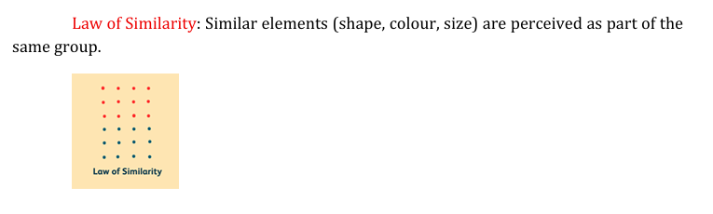
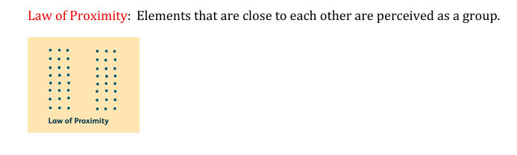
Gestalt psychology

Slide 8
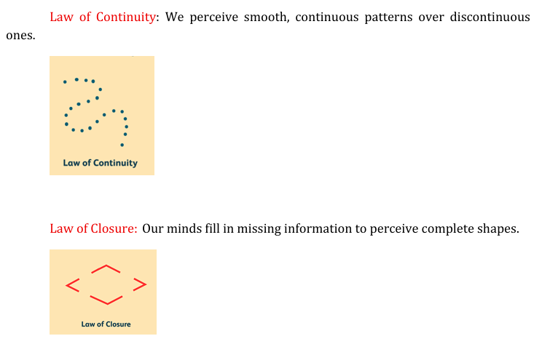
Gestalt psychology

Slide 9
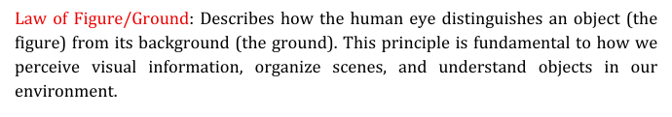
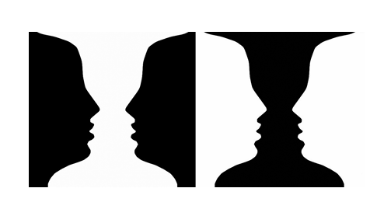
Gestalt psychology

Slide 10
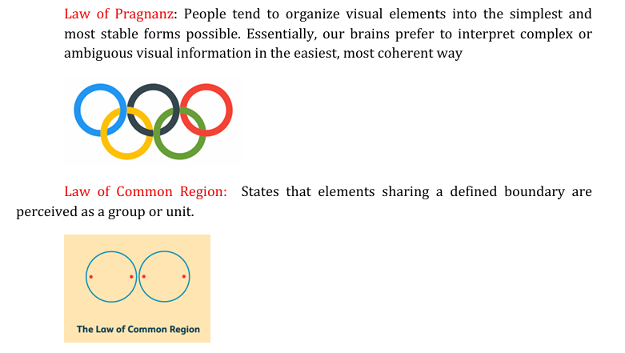
Gestalt psychology

Slide 11
Schools of Psychology
6. Humanistic Psychology (considered early by some, but mainly mid-20th century)
Founders: Abraham Maslow, Carl Rogers
Focus: Human growth, free will, self-actualization
Reaction against psychoanalysis and behaviorism.

Slide 12
Methods of psychology
Experimental Method: Studies cause–effect relationships by manipulating variables under controlled conditions.
Observation Method: Involves watching and recording behavior in natural or controlled settings.
Case Study Method: Provides an in-depth and detailed study of a single individual or small group.
Survey Method: Collects information from large groups using questionnaires or interviews.
Interview Method: Gathers detailed information through direct verbal interaction.
Psychological Testing: Measures psychological traits like intelligence, personality, and aptitude using standardized tests.
Correlational Method: Examines the relationship between two variables without manipulation.

Slide 13
Scope /fields of psychology:
.
Clinical Psychology: Diagnosing and treating mental and emotional disorders.
Counselling Psychology: Helping people solve personal, social, and adjustment problems.
Educational Psychology: Studying learning processes to improve teaching and education.
Developmental Psychology: Understanding human growth from infancy to old age.
Social Psychology: Studying how people think, feel, and behave in social situations.
Industrial/Organizational Psychology: Improving workplace behavior, productivity, and employee well-being.
Health Psychology: Exploring how psychological factors affect physical health and illness.
Cognitive Psychology: Studying mental processes like memory, thinking, and problem-solving.
Biological Psychology: Examining how the brain and nervous system influence behavior.
Forensic Psychology: Applying psychology in legal and criminal justice settings.
Sports Psychology: Enhancing performance and motivation in athletes.
Environmental Psychology: Studying how surroundings affect human behavior

Slide 14
Scope /fields of psychology:
.
Clinical Psychology: Diagnosing and treating mental and emotional disorders.
Counselling Psychology: Helping people solve personal, social, and adjustment problems.
Educational Psychology: Studying learning processes to improve teaching and education.
Developmental Psychology: Understanding human growth from infancy to old age.
Social Psychology: Studying how people think, feel, and behave in social situations.
Industrial/Organizational Psychology: Improving workplace behavior, productivity, and employee well-being.
Health Psychology: Exploring how psychological factors affect physical health and illness.
Cognitive Psychology: Studying mental processes like memory, thinking, and problem-solving.
Biological Psychology: Examining how the brain and nervous system influence behavior.
Forensic Psychology: Applying psychology in legal and criminal justice settings.
Sports Psychology: Enhancing performance and motivation in athletes.
Environmental Psychology: Studying how surroundings affect human behavior

